Slide 1
PinkBox
By: Aarithi Rajendren, Lara Afont, Erriana Thomas, Isabelle Carminati
An Application for Movie Lovers

Slide 2
Overview
1
2
3
Introductions
Value Proposition
Technical Debt
4
5
6
Stretch Goals
Code Overview
Live Demo
Group Members and their role on the team
Uniqueness of our Application
Unimplemented Features
Next steps and issues
A display of Frontend & Backend
A live demo of PinkBox

Slide 3
01.
Introductions

Slide 4
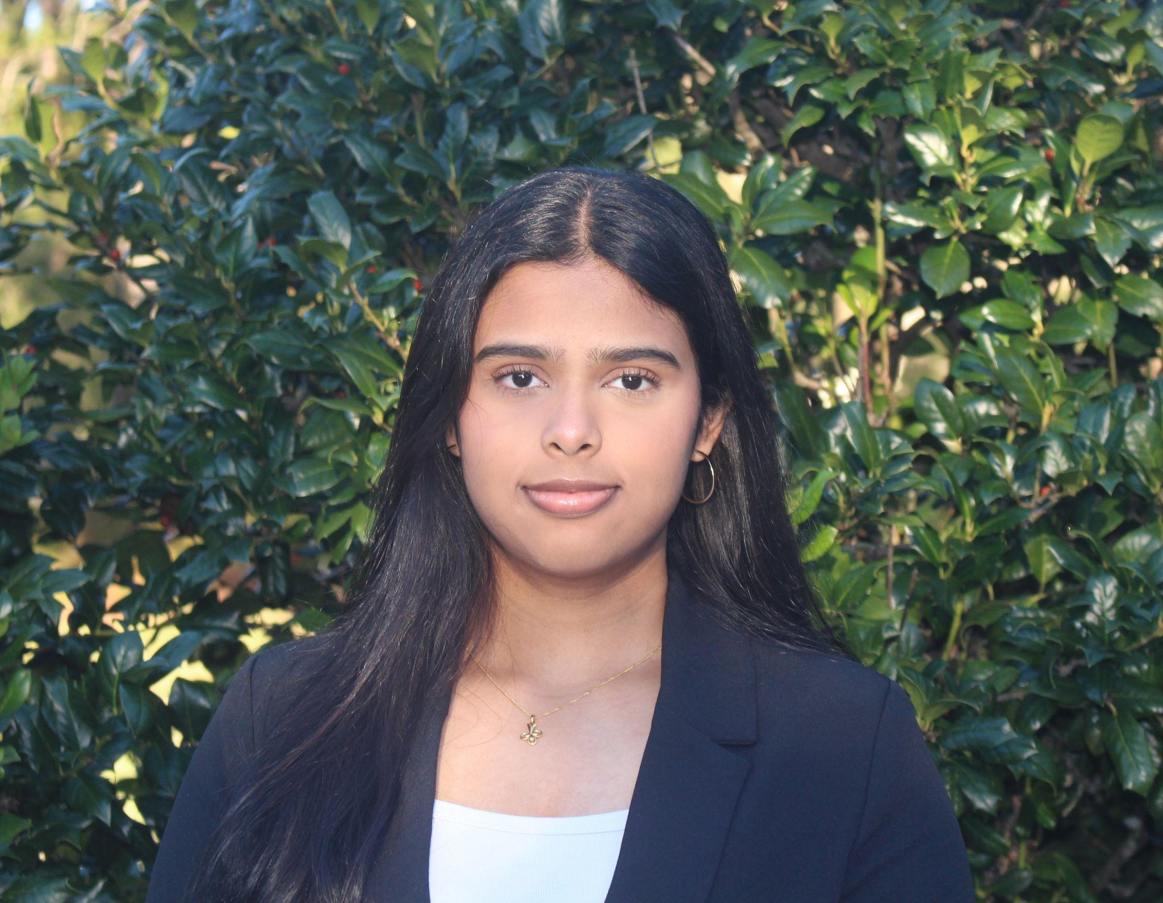
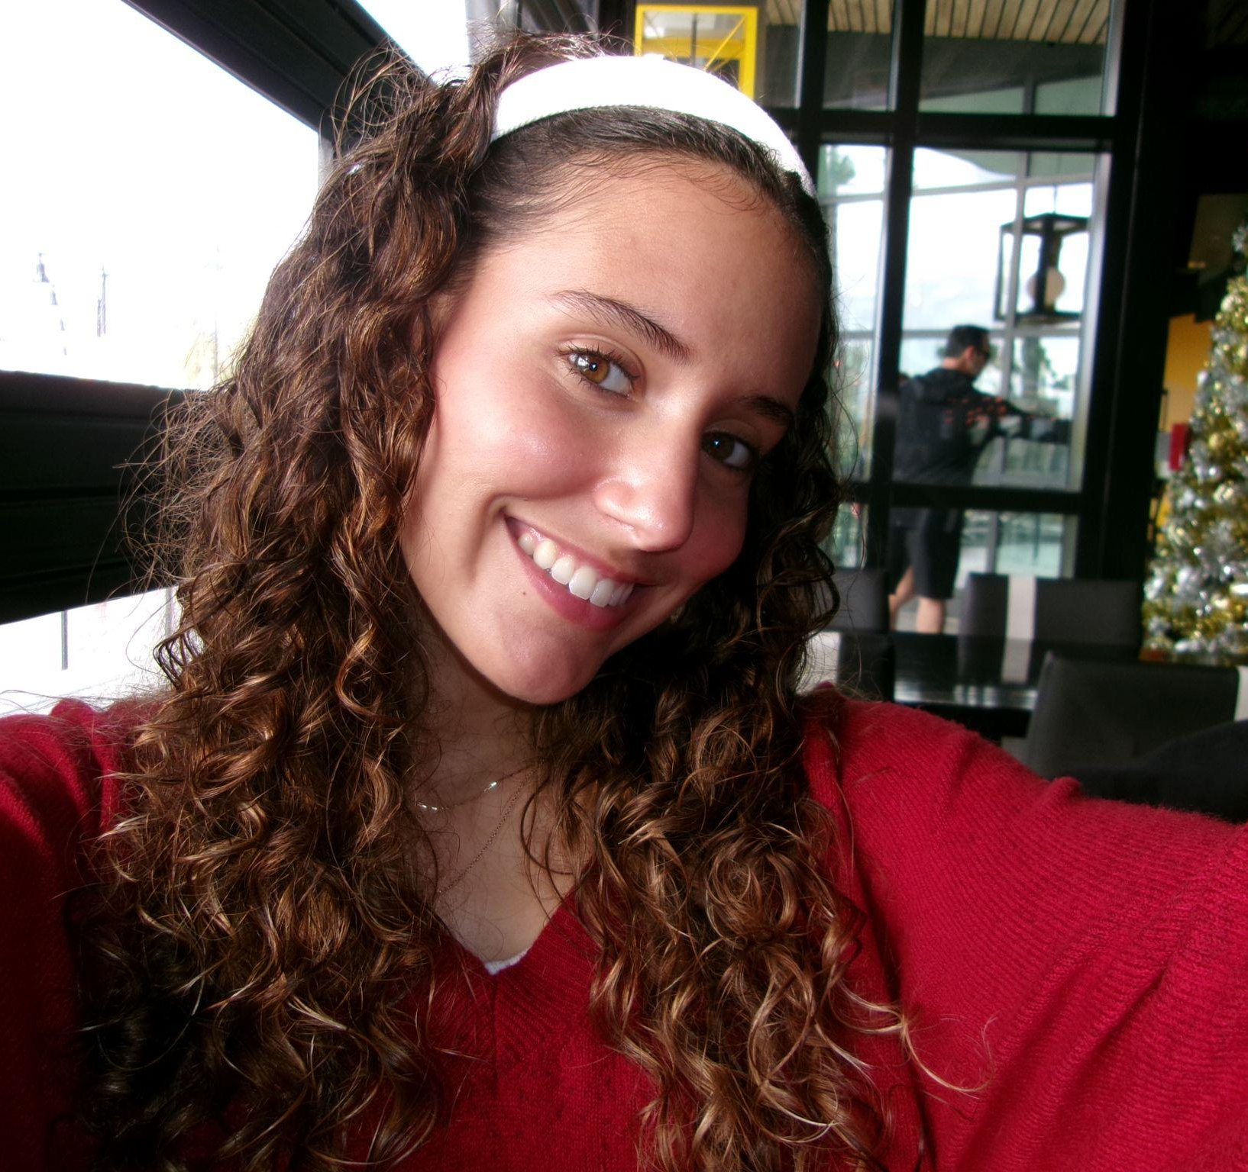

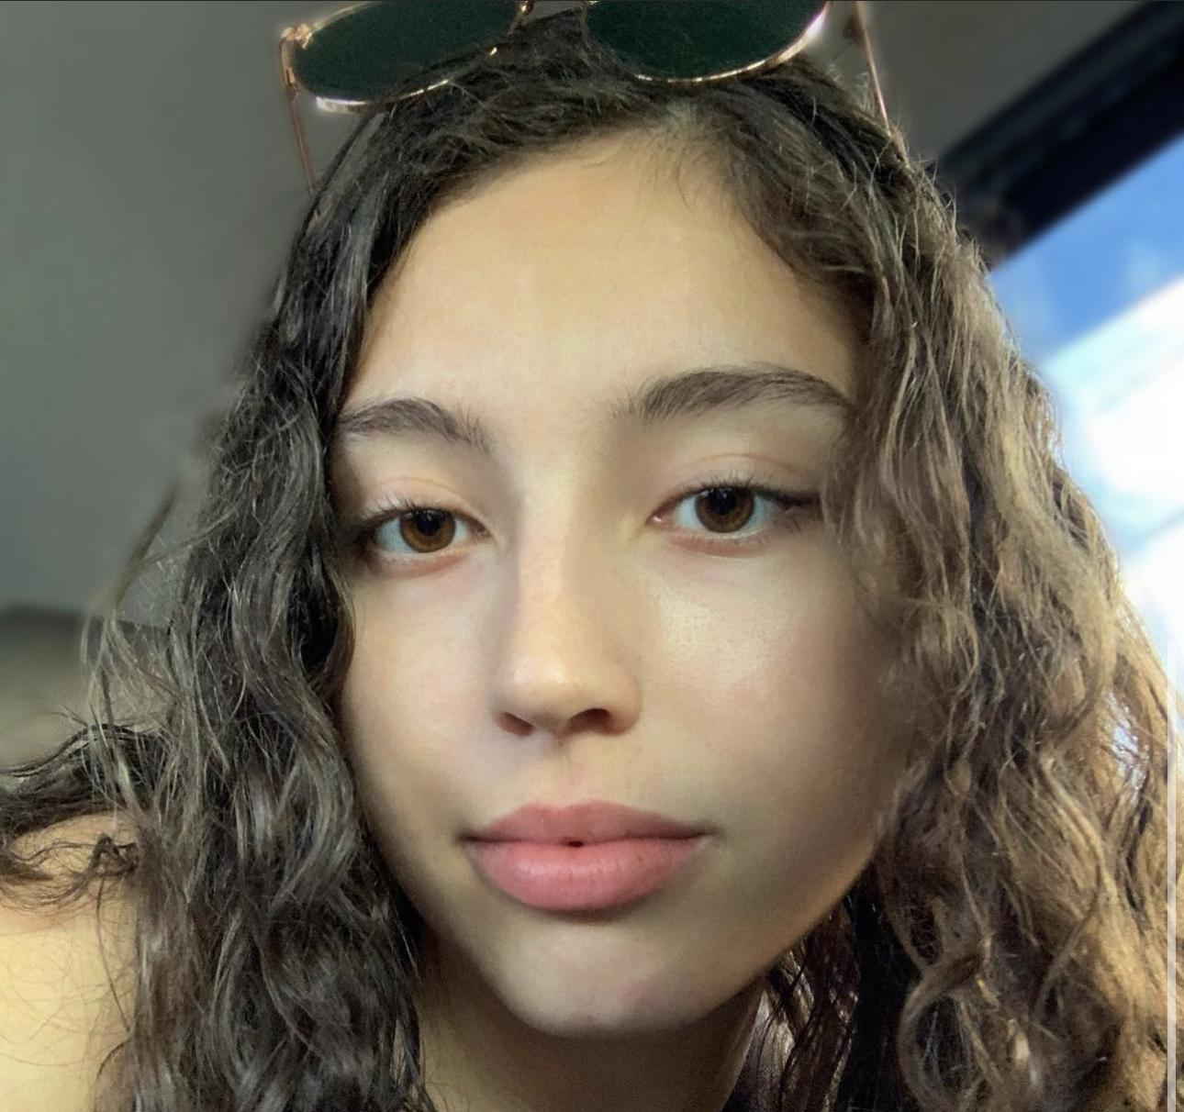
Our Team
Aarithi Rajendren
Lara Afont
Erriana Thomas
Isabelle Carminati
Back-end Developer
Back-end Developer
Front-end Developer
Front-end Developer

Slide 5
02.
Value Proposition
Why PinkBox is unique

Slide 6
Why Pinkbox is Unique
Most movie-streaming platforms do not offer a centralized, trustworthy platform to buy, sell, and manage physical or digital movie copies. These existing platforms are messy on which platform offers which movie, and it’s very hard for movie lovers to find one site where they can get access to all of their favorite movies.
PinkBox is our solution. We are building a marketplace to simplify the buying, selling, and curating experience for movie lovers. We have category filtering and platform-based sorting (including Netflix, Hulu, etc) to make movie searching seamless and user-friendly.
We offer a streamlined shopping experience with modern UI and cart quantity logic.
Integrates wishlist saving for future interest and planning.
Provides users with the ability to search by streaming service or genre.
Whether you’re someone looking for your next movie night pick or a collector trying to expand your library, PinkBox empowers users to take control of their movie-buying experience in a personalized way.

Slide 7
03.
Technical Debt
Sacrifices

Slide 8
Overlooked Technical Details
Concurrency Control
Load & Performance Testing
Our cart update logic doesn’t prevent two changes from happening at the exact same time at the database/json document level.
We’ve only tried PinkBox using a small movie catalog and a handful of users.
Notes:
For example, if you open your cart in two browser tabs (or on two devices) and add or remove items simultaneously, one update can overwrite the other—dropping items or applying the wrong quantities. To fix this, we’ll need to add a simple “lock” so only one update runs at once or bundle all the cart steps into one atomic operation (so they all succeed or all roll back). Once in place, this will stop those race‑condition glitches during busy shopping periods and lay the groundwork for features like live inventory syncing.
We haven’t measured what happens when you load tens of thousands of titles or when dozens—or even hundreds—of shoppers search, browse, and update carts at the same time. Because of this, we don’t know our page‑load times, API response times, or database CRUD speeds under real‑world traffic. To close this gap, we’ll need to set up automated load tests that ramp up the number of simulated users and data volume. That will reveal bottlenecks, help us tune performance, and ensure PinkBox stays fast and reliable as we grow.

Slide 9
Robustness/Quality of Code Trade-offs
No caching: Every request still hits our APIs and database directly. This speeds up development but means repeated lookups of the same movie lists can slow down page loads under traffic.
Basic security: We’ve skipped multi‑factor authentication and strict password policies. That saved initial implementation time but leaves gaps we’ll need to close for a truly robust, secure platform.
Role-Based Access Control: We have not implemented roles such as what a customer can do and what admins can do. For an example, admins should be able to block certain offenders or block certain credit card usage etc.,
Logging & Auditing: We don’t save any records of when people sign in or sign out, nor do we capture details about errors or crashes. Without those logs, it’s hard to see who did what or to understand—and fix—any problems that come up.

Slide 10
04.
Stretch Goals
Further Implementations

Slide 11
Goals Post-Sprint 2
1.
2.
3.
4.
Expanding on our bank of Movies
Provide a more secure authentication process
Give access to additional streaming services
Aim to obtain a domain for our site

Slide 12
05.
Code Overview
Display of Frontend & Backend

Slide 13
06.
Live Demo!
Notes:
Erriana’s slide

